Slide 1
IMAGE PRE-PROCESSING
-The ﬁrst step in the processing chain, often referred
to as pre-processing.
-Pre-processing operations / image restoration and rectification - ‘ intended to correct for data errors.’
Two groups of image pre-processing:
-Radiometric data characteristics
-Geometric distortions of data.

Slide 2
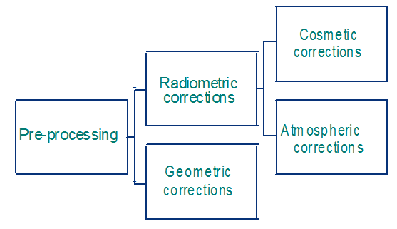

Slide 3
i. Cosmetic corrections
Involve all those operations that are aimed at correcting
visible errors and noise in the image data.
-Defects may be in the form of
-Periodic or random
-Missing lines (line dropouts),
-Line striping, and
-Random or spike noise.
*These effects can be identiﬁed visually.

Slide 4
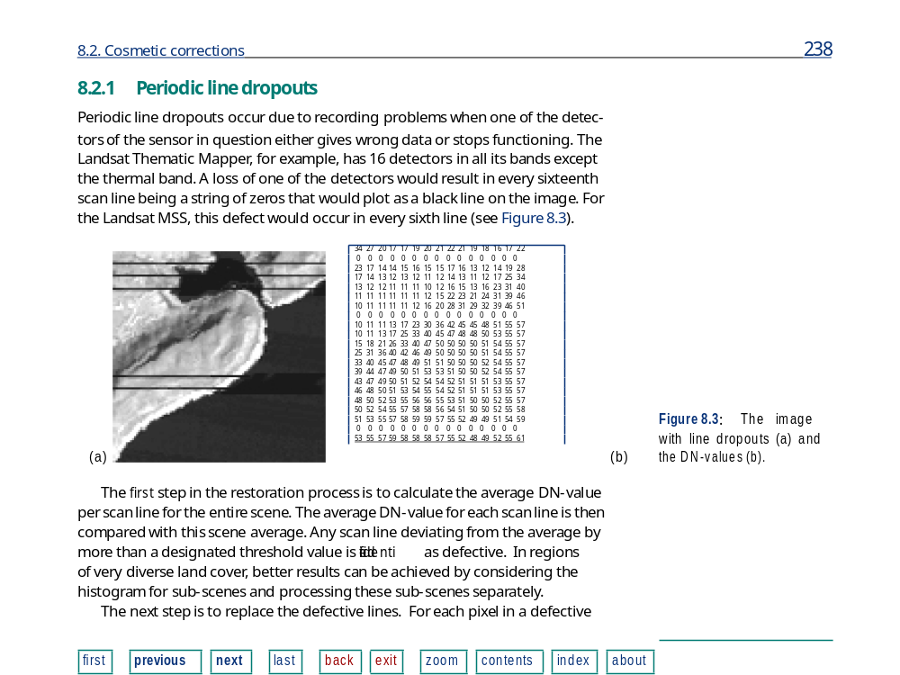
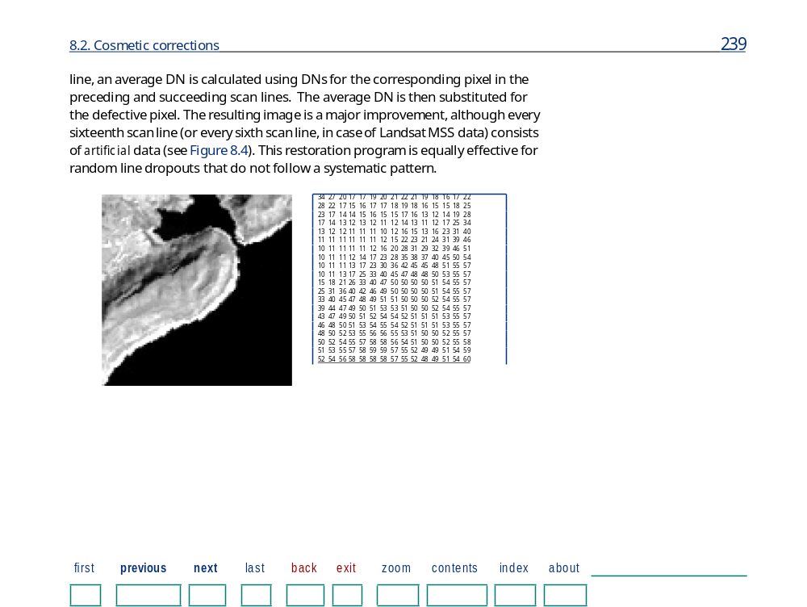
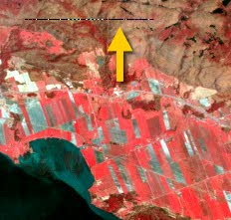
Periodic line dropouts
Periodic line dropouts occur due to recording problems when one of the
detectors of the sensor in question either gives wrong data or stops functioning.

Slide 5
b) Line striping
- Line striping is far more common than line dropouts are.
Line striping often occurs due to non-identical
detector response.
*Although carefully calibrated and matched at launch of
satellite, response of some detectors
may drift to higher or lower Levels with time.
-As a result, every scan line recorded by that detector is
brighter or darker than the other lines.

Slide 6
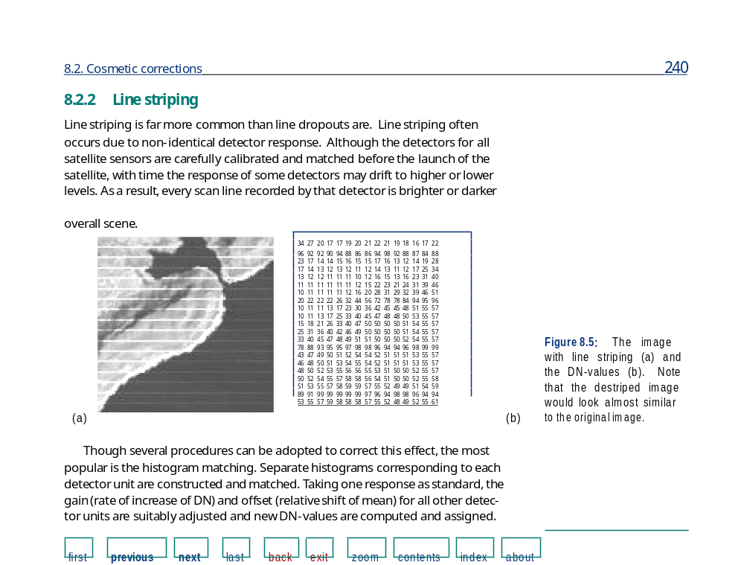

Slide 7
c) Random noise or spike noise
-The periodic line dropouts and striping are forms
of non-random noise
*recognised and restored by simple means.
-Random noise - requires a more sophisticated
restoration eg digital ﬁltering.
-Occur due to errors during transmission of
data or to a temporary disturbance.
* pixels acquire DN-values that are much higher
or lower than the surrounding pixels producing
bright and dark spots that interfere with
information extraction procedures.

Slide 8
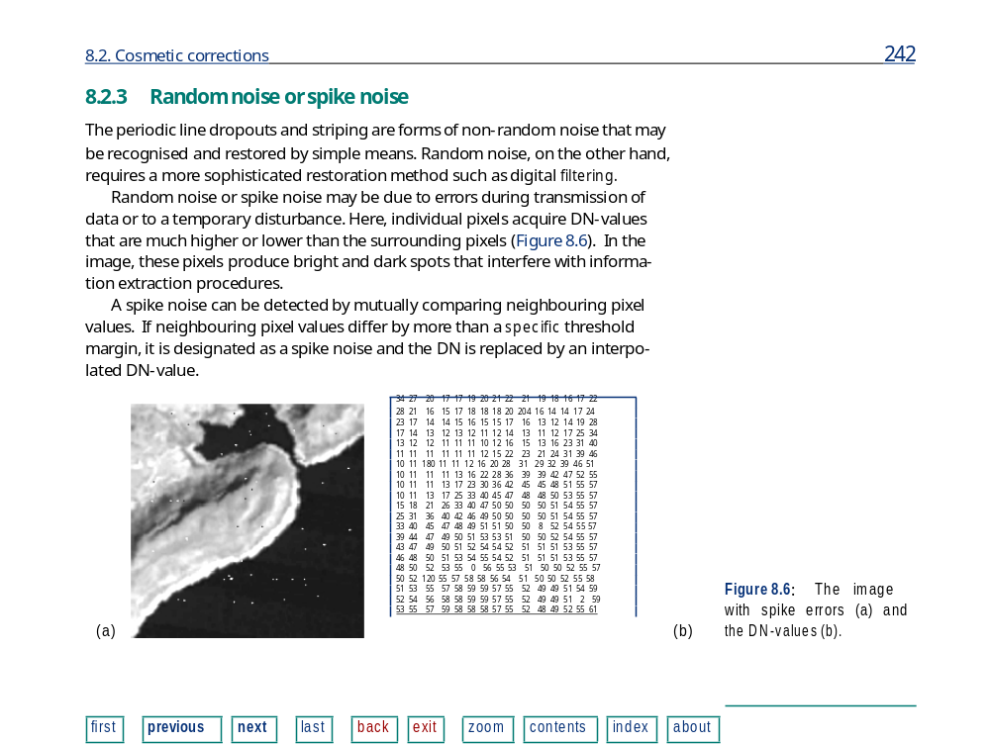

Slide 9
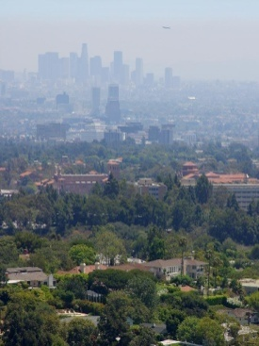
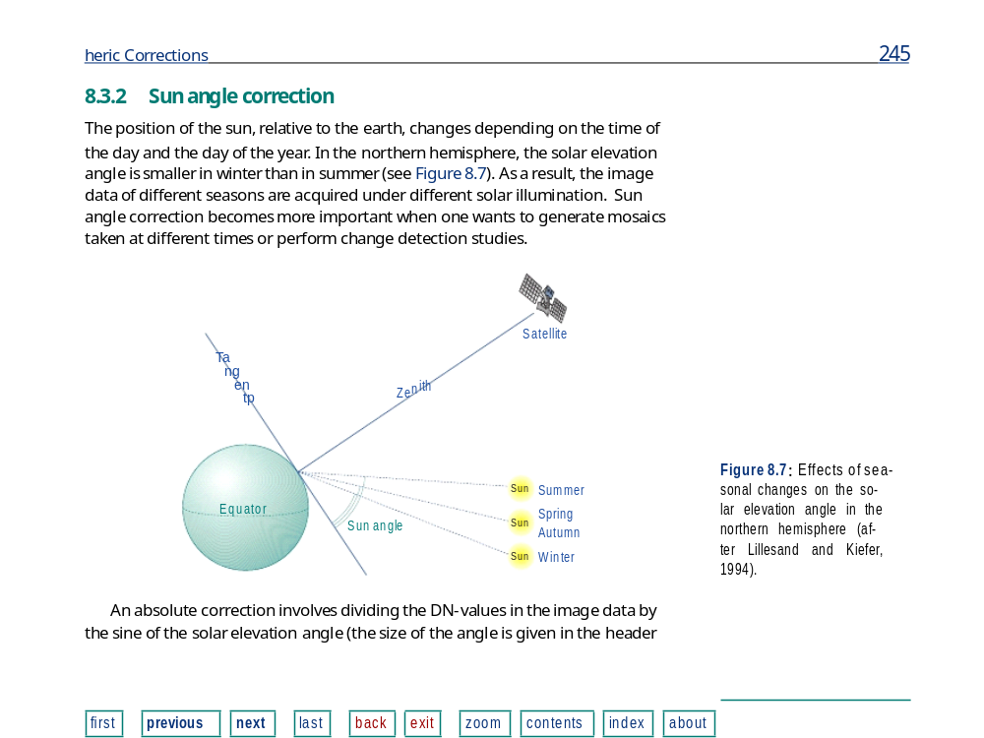
2. Atmospheric Corrections
-All reﬂected and emitted radiations leaving the
Earth’s surface are attenuated mainly due to absorption and
scattering by the constituents in the atmosphere.
-The atmospheric induced distortions occur twice in case of
sunlight reﬂection and once in case of emitted radiation.
These distortions are wavelength dependent.
· haze,
· sun angle and skylight.
-These effects can be reduced by applying ‘atmospheric
correction’ techniques.
Atmospheric corrections
Compensate for the effect of atmospheric
and illumination parameters;

Slide 10
ii. Geometric corrections
Imagery are inherently subject to geometric distortions.
-the perspective of the sensor optics;
-the motion of the scanning system
-the motion of the platform;
-the platform altitude,
-the terrain relief
- curvature etc

Slide 11
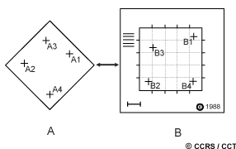
-Geometric corrections are intended to compensate for these distortions so that the geometric representation of the imagery will be as close as possible to the real world.

Slide 12
The geometric registration process involves identifying the image coordinates (i.e. row, column) of several clearly discernible points, called ground control points (or GCPs), in the distorted image and matching them to their true positions in ground coordinates (e.g. latitude, longitude).
-The true ground coordinates are typically measured from a map, either in paper or digital format. This is image-to-map registration.
-Once several well-distributed GCP pairs have been identified, the coordinate information is processed by the computer to determine the proper transformation equations to apply to the original (row and column) image coordinates to map them into their new ground coordinates.

Slide 13
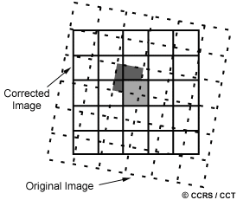
-Geometric registration may also be performed by registering one (or more) images to another image, instead of to geographic coordinates. This is called image-to-image registration and is often done prior to performing various image transformation procedures.

Slide 14
-In order to actually geometrically correct the original distorted image, a procedure called resampling is used to determine the digital values to place in the new pixel locations of the corrected output image.
There are three common methods for resampling:
-Nearest neighbour,
-Bilinear interpolation, and
-Cubic convolution

Slide 15
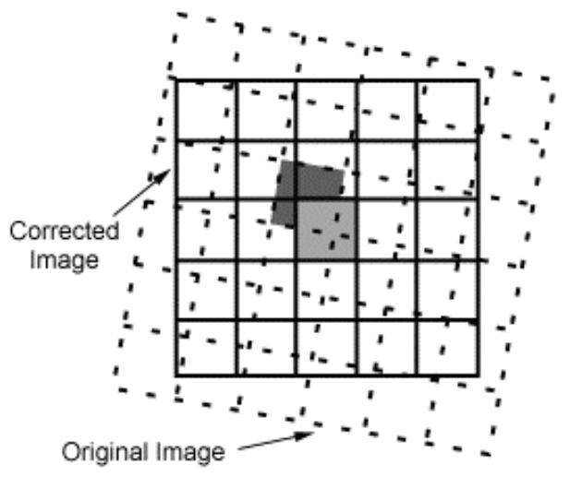
Nearest neighbour resampling uses the digital value from the pixel in the original image which is nearest to the new pixel location in the corrected image.
-This is the simplest method and does not alter the original values

Slide 16
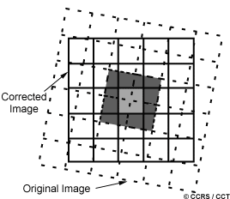
2. Bilinear interpolation-resampling takes a weighted average of four pixels in the original image nearest to the new pixel location.
-The averaging process alters the original pixel values and creates entirely new digital values in the output image.

Slide 17
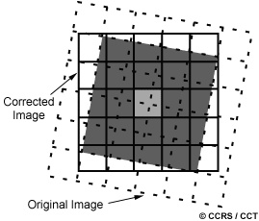
3. Cubic convolution resampling goes further to calculate a distance weighted average of a block of sixteen pixels from the original image which surround the new output pixel location.
-As with bilinear interpolation, this method results in completely new pixel values.

